Slide 1
Cloud Computing
SEWP ZG527

Slide 2
SaaS – Agenda
What is SaaS?
Traditional Model
How is it delivered?
SaaS Architecture
SaaS Models
Advantages of SaaS
User and Vendor benefits of SaaS
2

Slide 3
SaaS – Architecture
Run by
Bandwidth technologies
The cost of a PC has been reduced significantly with more powerful computing but the cost of application software has not followed
Timely and expensive setup and maintenance costs
Licensing issues for business are contributing significantly to the use of illegal software and piracy.
Notes:
RL 5.2

Slide 4
SaaS Application Architecture
Scalable
Multitenant efficient
Configurable
Scaling the application - maximizing concurrency, and using application resources more efficiently
i.e. optimizing locking duration, statelessness, sharing pooled resources such as threads and network connections, caching reference data, and partitioning large databases.

Slide 5
SaaS Application Architecture
Multi-tenancy – important architectural shift from designing isolated, single-tenant applications
One application instance must be able to accommodate users from multiple other companies at the same time
All transparent to any of the users.
This requires an architecture that maximizes the sharing of resources across tenants
is still able to differentiate data belonging to different customers.

Slide 6
SaaS Application Architecture
Configurable - a single application instance on a single server has to accommodate users from several different companies at once
To customize the application for one customer will change the application for other customers as well.
Traditionally customizing an application would mean code changes
Each customer uses metadata to configure the way the application appears and behaves for its users.
Customers configuring applications must be simple and easy without incurring extra development or operation costs

Slide 7
SaaS Introduction Cont.….
SaaS is one of the fastest growing concepts: more than 30 million companies will be using SaaS in the next 5 - 10 years; more than 70% of all Fortune 500 companies are already using SaaS
According to influential IT institutes, SaaS is the leading business model of choice
Virtually all big software/service vendors (IBM, Microsoft, Oracle, Cisco) are investing heavily in SaaS
With the continuously increasing bandwidth and reliability of the internet, using web services over the (public) internet has become a viable option

Slide 8
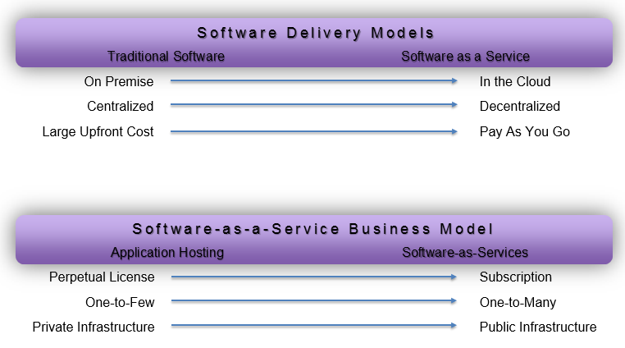
SaaS Models

Slide 9
Business Model comparisons
Traditional packaged software
Software as a service
Designed for customers to install, manage and maintain.
Designed from the outset up for delivery as Internet-based services
Architect solutions to be run by an individual company in a dedicated instantiation of the software
Designed to run thousands of different customers on a single code

Slide 10
Business Model comparisons
Traditional packaged Software
Software as a serivce
Infrequent, major upgrades every 18-24 months, sold individually to each installed base customer.
Frequent, "digestible" upgrades every 3-6 months to minimize customer disruption and enhance satisfaction.
Fixing a problem for one customer fixes it for everyone
Version control
Upgrade fee
Streamlined, repeatable functionality via Web services, open APIs and standard connectors
May use open APIs and Web services to facilitate integration, but each customer must typically pay for one-off integration work.
Company name

Slide 11
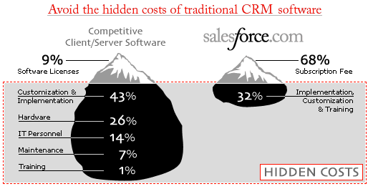
Business Model comparisons
Hidden Cost

Slide 12
Thanks!!!
Queries?

